Slide 1
What is a Thread?
In C#, a Thread is a basic unit of execution within a process.
Threads allow your program to perform multiple operations concurrently
Thread is a basic unit of code having separate execution path with in the program.
Threads are essential for tasks like handling UI events, background processing, or long-running operations without blocking the main application.
Execution of the thread completely depends on the underlying OS.
A process can have multiple threads.
Each thread shares memory with other threads in the same process.
The System.Threading.Thread class is used to create and manage threads.

Slide 2
Working with threads
There are 3 fundamental steps to work with thread
Creating an object of type System.Threading.Thread
Passing ThreadStart delegate to its constructor.
Calling start on the thread object
The Thread class is sealed.
Calling start on the thread causes a thread to execute asynchronously the method assigned to the delegate.
When the thread finishes executing it dies.

Slide 3
About Thread class
Declaration:
Thread t=new Thread(task1)
Thread t1=new Thread(task2)
Note: Thread class is sealed so it cannot be inherited.
public Thread(ThreadStart start);
The signature of the delegate is
public delegate void ThreadStart()
Any method that is passed to this delegate must match its signature.
That means method must return void and it takes no parameters.

Slide 4
Thread Methods and Properties
Thread Class come up with various methods and properties to control the execution of threads.
Start()-it will start thread execution.
Start(object obj): This is Required when we pass a argument to thread
Sleep(int millisecondsTimeout) :it will stop thread execution for specified mille secs
Sleep(TimeSpan timeout): Timespan can allow timeout in the form of min-hours secs etc.
Suspend()-it will suspend thread execution[if the thread is already suspended, has no effect.]
Resume()-it will start thread execution, that has been suspended[i.e. it starts the suspended threads]
Abort()-it will terminates thread execution, once thread is aborted it will not be started[compile will rise the Thread exception]

Slide 5
Thread Methods and Properties
Property:
CurrentThread:Gets the current running thread object.
IsAlive:Gets execution status of current thread. It Return true when the thread is running else returns false.
Name: Gets or sets the name of the thread.

Slide 6
Thread Methods and Properties
ThreadState:Gets a state of the current thread.
Thread State | Description
Unstarted | Thread is Created within the common language run time but not Started still.
Running | After a Thread calls Start method
WaitSleepJoin | After a Thread calls its wait or Sleep or Join method.
Suspended | Thread Responds to a Suspend method call.
Stopped | The Thread is Stopped, either normally or Aborted.

Slide 7
Passing information to the thread methods
The ThreadStart delegate does not allow us to pass any values to the method.
We can of course use the instance variables of the class in which the delegate method is defined.
But in case we need to explicitly pass some data then this can be done using another delegate called ParameterizedThreadStart
public delegate void ParameterizedThreadStart(Object obj )
This delegate can be passed to the Thread constructor.
The object can be passed using the method
void Start(Object param)

Slide 8

Join()
Join() makes the calling thread wait until the given thread terminates.
If time is specified, thread waits until the given thread terminates or the specified time elapses
public void Join();
public bool Join(int time);
public bool Join(TimeSpan time);
using System;
using System.Threading;
public class JoinClass{
public static void Main() {
Thread paramThread = new Thread(PassParam);
paramThread.Start("Test");
paramThread.Join();
Console.WriteLine("end of main"); }
private static void PassParam (object o) {
Console.WriteLine("Param : {0}", o); }}

Slide 9
Priority
The execution of the thread depends on its priority
The Priority of the thread can be changed by using the Priority property.
ThreadPriority enumeration defines values for Priority property.
Values can be AboveNormal, BelowNormal, Highest, Lowest, Normal
By default, all the thread are created with a Normal priority.
Please note that the underlying OS are not required to honor the priority of a thread.
The method throws a ThreadStateException if the thread has reached a final state, such as Aborted.
The method throws a ArgumentException if the value specified for a is not a valid ThreadPriority value.

Slide 10
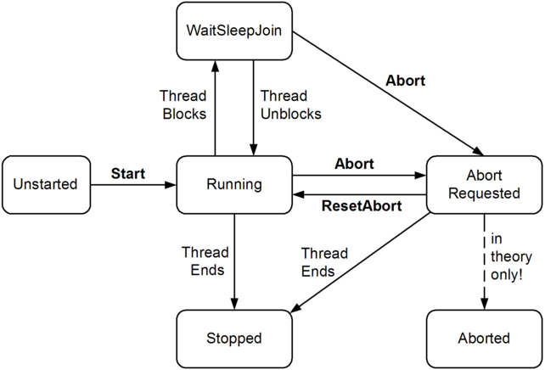

Slide 11
Drawbacks of Threads
Manual lifecycle management
Higher memory overhead
Limited scalability for I/O-bound tasks
Better replaced with Task, async/await, or ThreadPool in most scenarios

